Slide 1
I.Z.A.R
Integrated Zone Analysis and Reporting

Slide 2
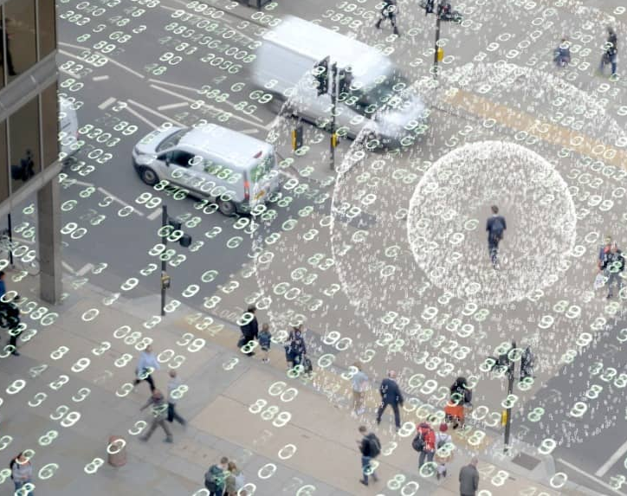
IZAR- Is an integrated all in one surveillance and reporting system which combines of Acoustic pattern detection, Drone Detection, MAC id detection, IMSI detection, Air quality detection and Accident Detection.

Slide 3
Sensor 1
Deep learning network
Big Data Analysis
Sensor 2
Communication Link
Control and Monitoring Center
Sensor 2
Sensor 4

Slide 4
Objectives
Public safety.
Disaster management.
Threat Identification.
Crime mitigation.
Pattern recognition.
Intelligence gathering.
Atmospheric Monitoring.
Air and ground surveillance.

Slide 5
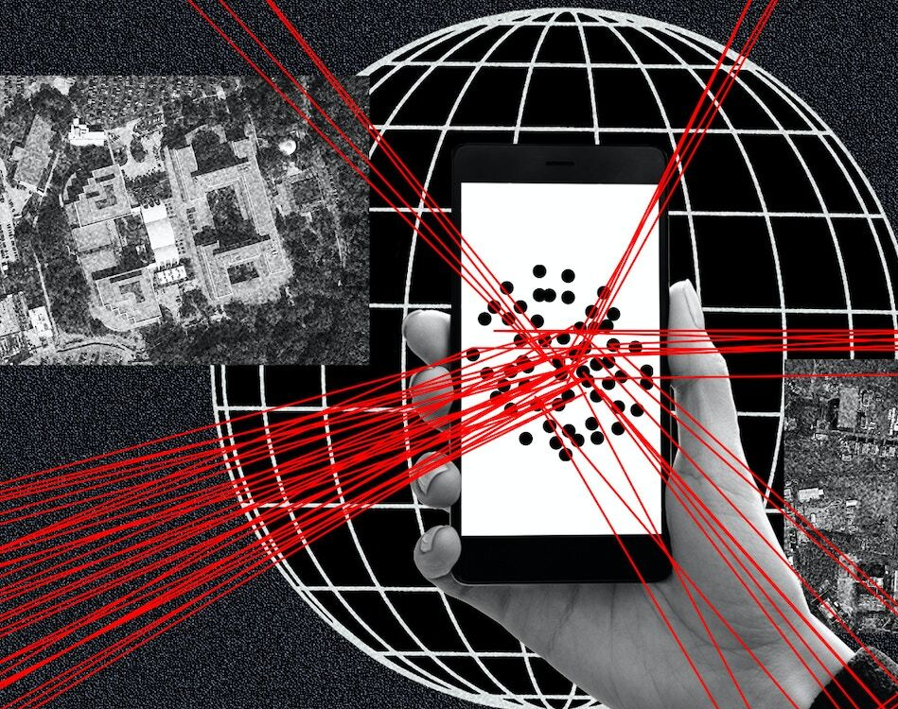
Breakdown of components.
Air Quality measuring unit.
Acoustic detectors for identification (e.g.: Gunshots, distress call).
Drone Detection system.
MAC address monitoring system.
IMSI monitoring system.

Slide 6
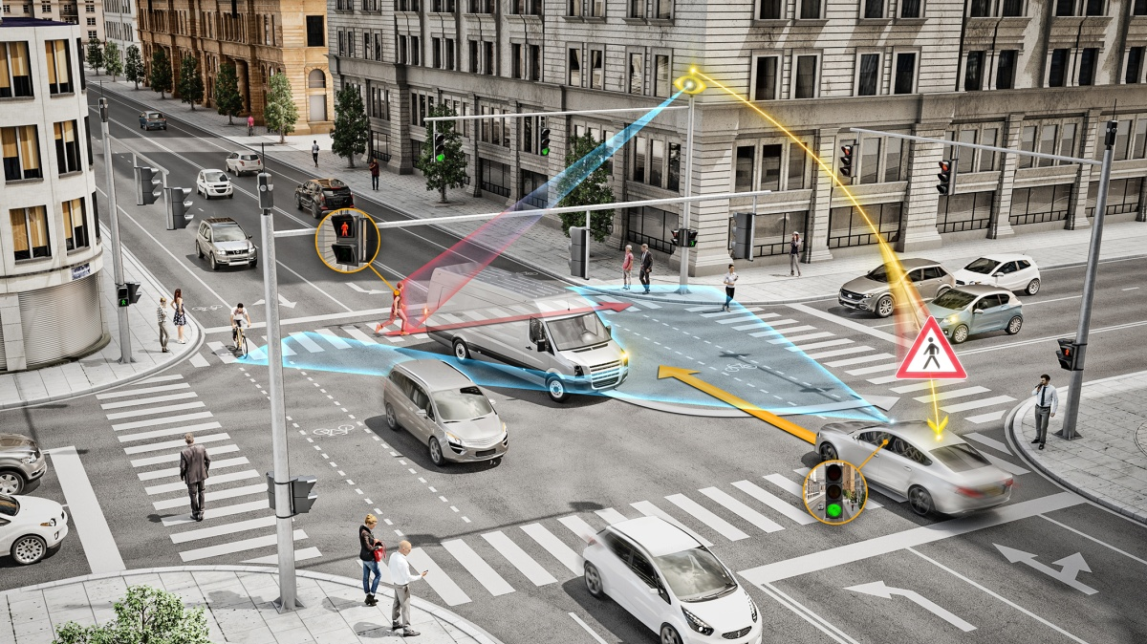

Slide 7
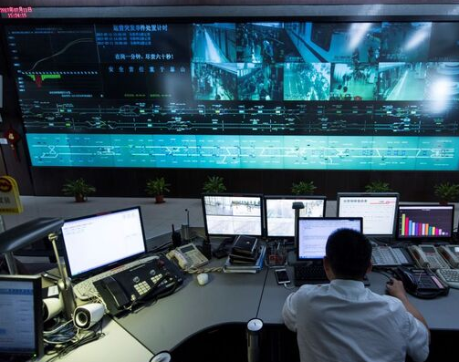
Setup
The device are fixed to various poles available on the street, if possible along with CCTV installations.

Slide 8
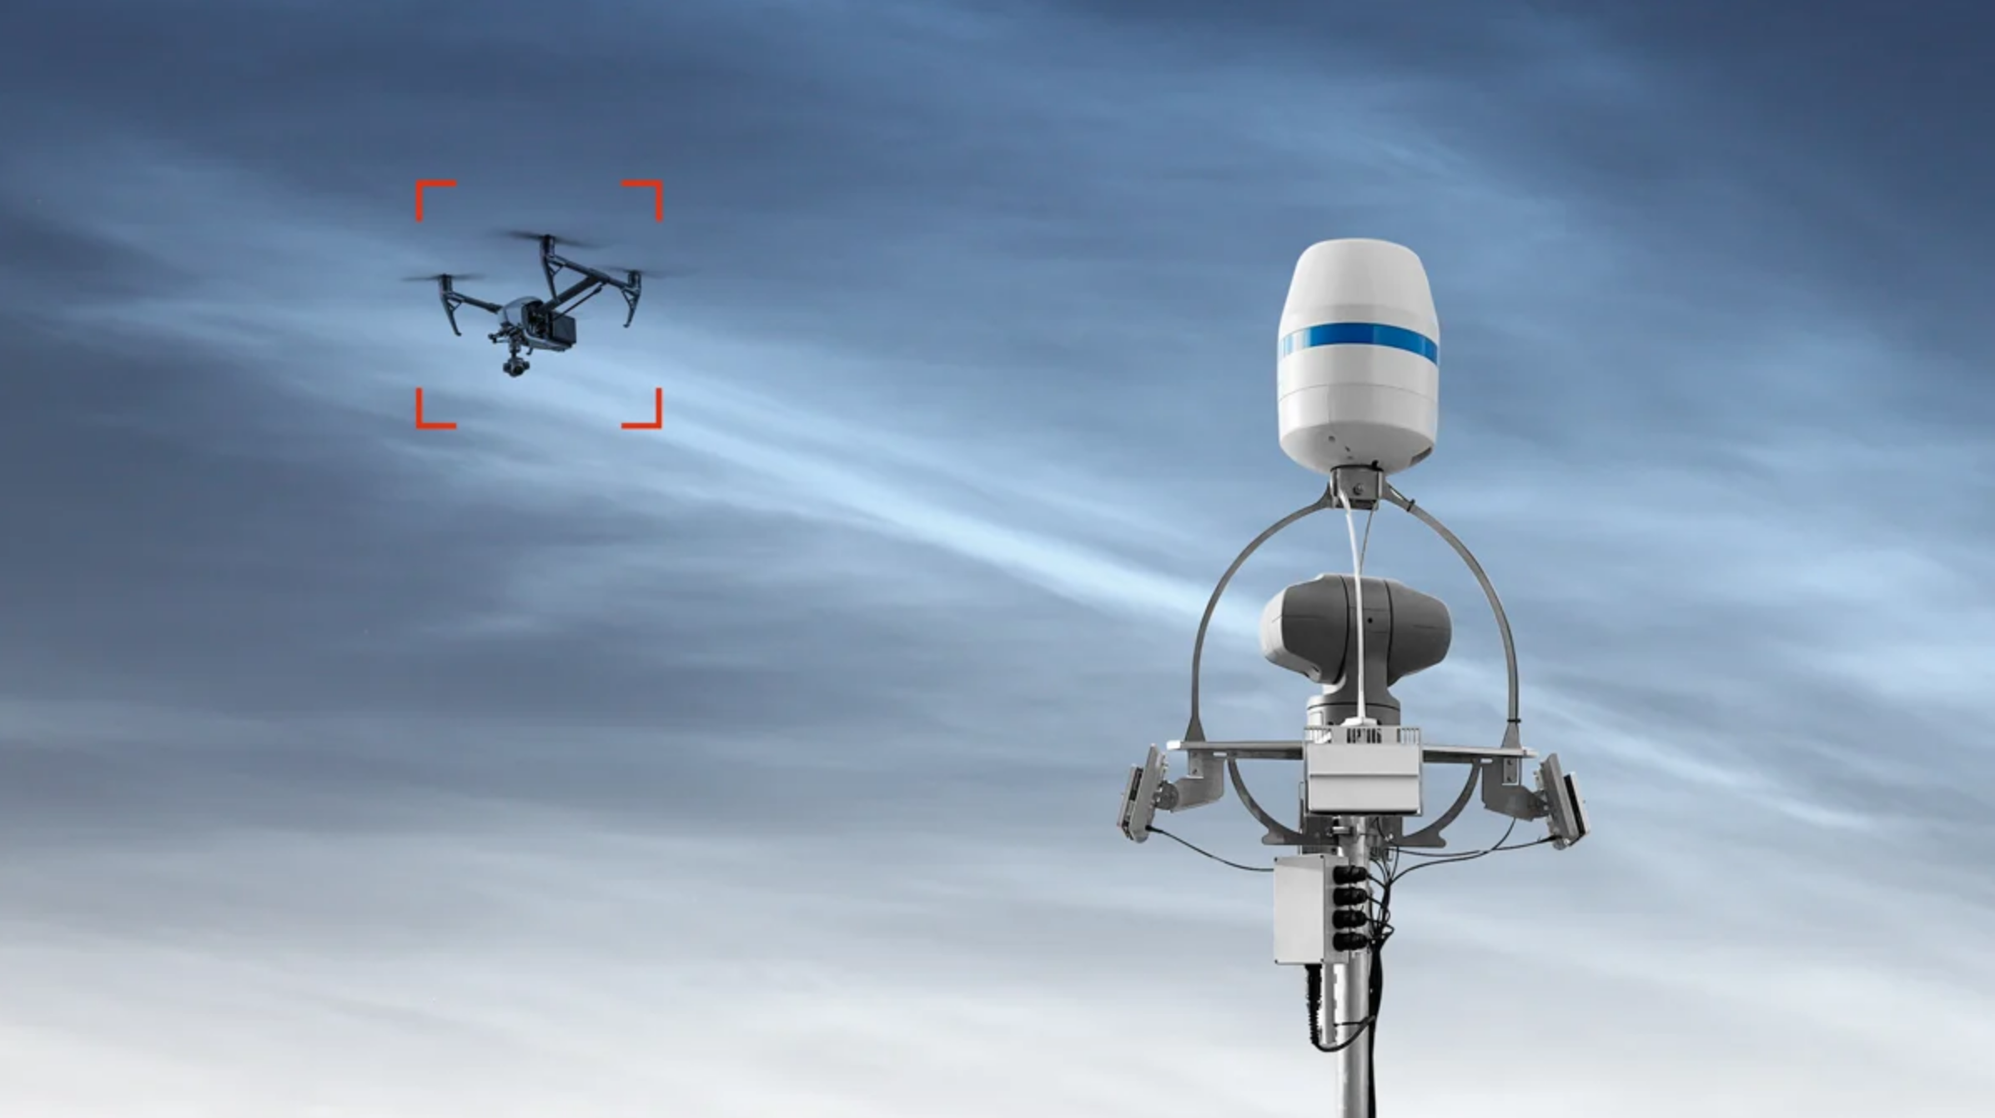
Advantages
Early warning systems on aerial threats.
Gunshot detection.
Identification of threats. (Terrorist)
Mitigation of threat from weaponized consumer drones.

Slide 9
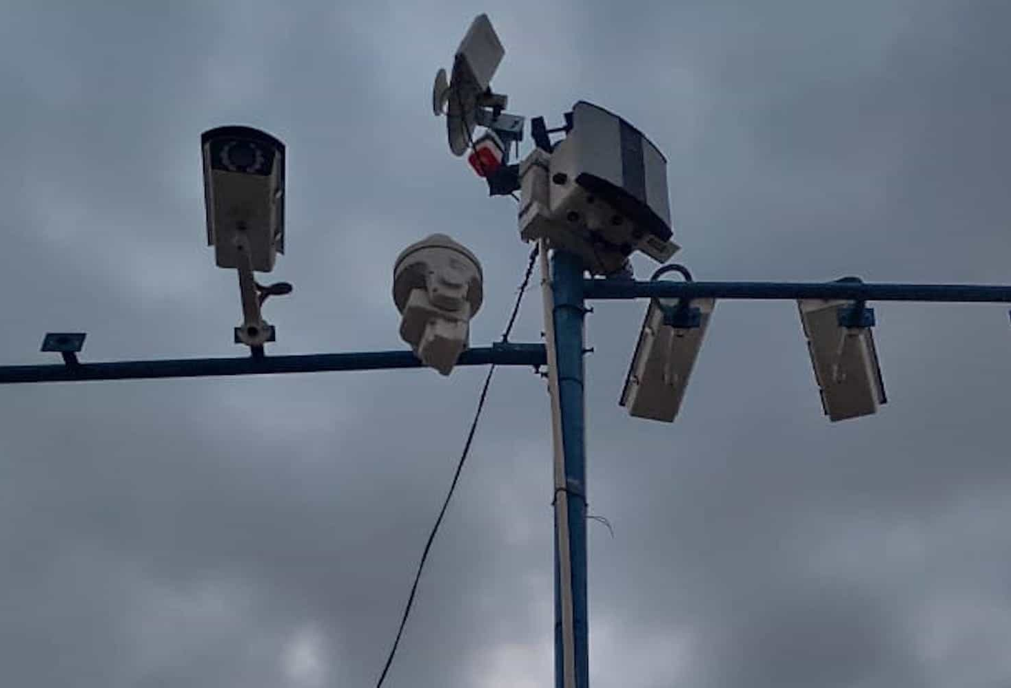
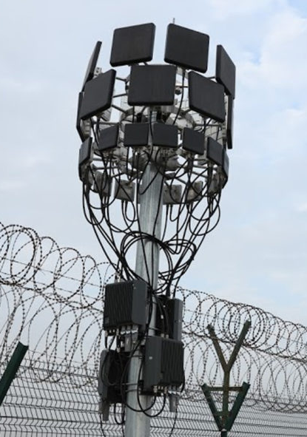
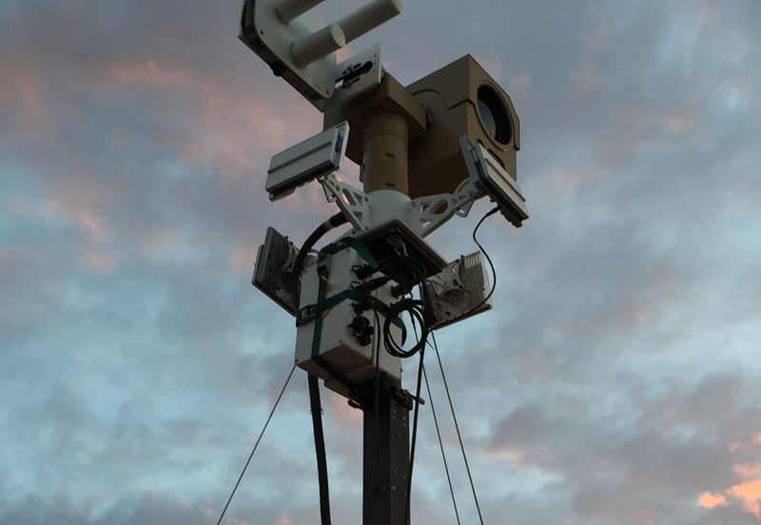
Advantages
Pattern detection to reveal threat actors like sleeper cells and foreign agent.
Crime detections.
Accident detection.
Effective utilization of government resources.
Early Warning system.

Slide 10
Thank You
Vivek Theyyathan Valappil

